Slide 1


SMART INDIA HACKATHON 2026
Problem Statement ID – 26223
Problem Statement Title – Disaster management and Risk mitigation System (Pre, During, Post Disaster)
Theme – Disaster Management
PS Category – Software + Hardware
Team ID -
Team Name - Innovexis

Slide 2
Aasha Setu
Team Innovexis
An integrated disaster management platform with pre, during and post disaster management systems.
Unifying authorities
We do not have a system to send SOS message without cellular network.
Lost & found cases become difficult to coordinate at the time of chaos.
Pre Disaster
Real-time information of rainfall, cyclone, flood, landslide chances
Monitors river level and river course change.
Offline downloadable maps available
A trapped person can send SOS message to nearby drone through wifi and bluetooth even without any network.
During Disaster
Provides info of nearest rescue centres, hospitals and lets to access offline map of the area.
Helps to check safety status of family members.
Post Disaster
Provides lost & found section to find and report loved ones.
Relays authorities messages regarding rescue.
Provides emotional support through chatbot to cure trauma.

Slide 3

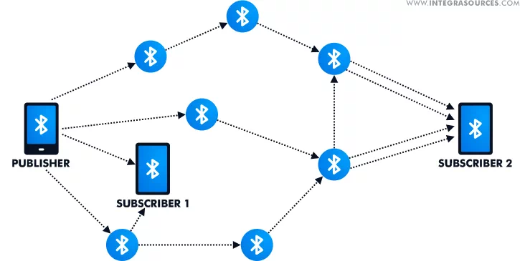
TECHNICAL APPROACH
Team Innovexis
Android Application
(Kotlin)
Command Dashboard Website
(Typsecript, Next.js)
Technologies used:
FastAPI
SOS signal
Frontend | Next.js 16, React 19, TS, Tailwind v4, MapLibre GL
Android | Kotlin, Jetpack Compose, Hilt, Room, WorkManager
Backend | FastAPI, SQLAlchemy 2 + GeoAlchemy2, Pydantic v2
Database | PostgreSQL 16 + PostGIS 3.4
Realtime | Server-Sent Events + in-process broker
Hardware / CV | ESP32-CAM, Ultralytics YOLO11 (n/s)
Hosting | Vercel · Render · Supabase (free tier)
Python backend
Other drones/citizens
within range
AI/ML Engine
YOLO, NLP
Decision Engine
Priority, dispatch
Authorities Dashboard
GIS Engine
PostGIS Queries
Routing Engine
Safe routes
PostgreSQL
+
PostGIS
API keys
IMD Weather, ISRO Bhuvan
Redis
(cache data)

Slide 4
IMPACT AND BENEFITS
Team Innovexis
From scattered hotlines to one auditable loop — on a low-end phone, for any disaster type.
FOR CITIZENS
Aspect | Today | With Aasha Setu
Hazard info | Generic city-wide bulletins | Per-GPS-point, 4 hazards, live
Who needs help | Phone calls, guesswork | Geotagged reports, ranked by priority
Report trust | Unverified, duplicated | Confidence score + human verify gate
Dispatch | Manual radio coordination | Nearest responder + OSRM safe route
When network drops | Nothing gets through | Queued SOS + offline map + drone relay (designed)
• Hazard forecast + risk for their exact location
• SOS with evidence that survives a dead network
• Nearest shelter / hospital; family safety status
FOR RESPONDERS & AUTHORITIES
• One prioritised queue — act on the right case first
• Verified incidents only; nearest-responder + safe route
• Area-wide alerts + live situational picture
SOCIAL
Faster help; families reconnected via check-ins; equal access on free OSM maps + low-end phones
SYSTEMIC
One platform for every hazard; structured data trail enables post-disaster audit & learning
One warning · one SOS · one verified rescue — that is the loop.

Slide 5
RESEARCH AND REFERENCES
Team Innovexis
ESP 32 Documentation
ISRO Bhuvan
ESP-32 Documentation
Disaster management in India
Link to ISRO Bhuvan
Link
Link to Github Repository of Project -->
Link to Asha Setu Website -->
Link to Authority Dashboard -->

